Slide 1
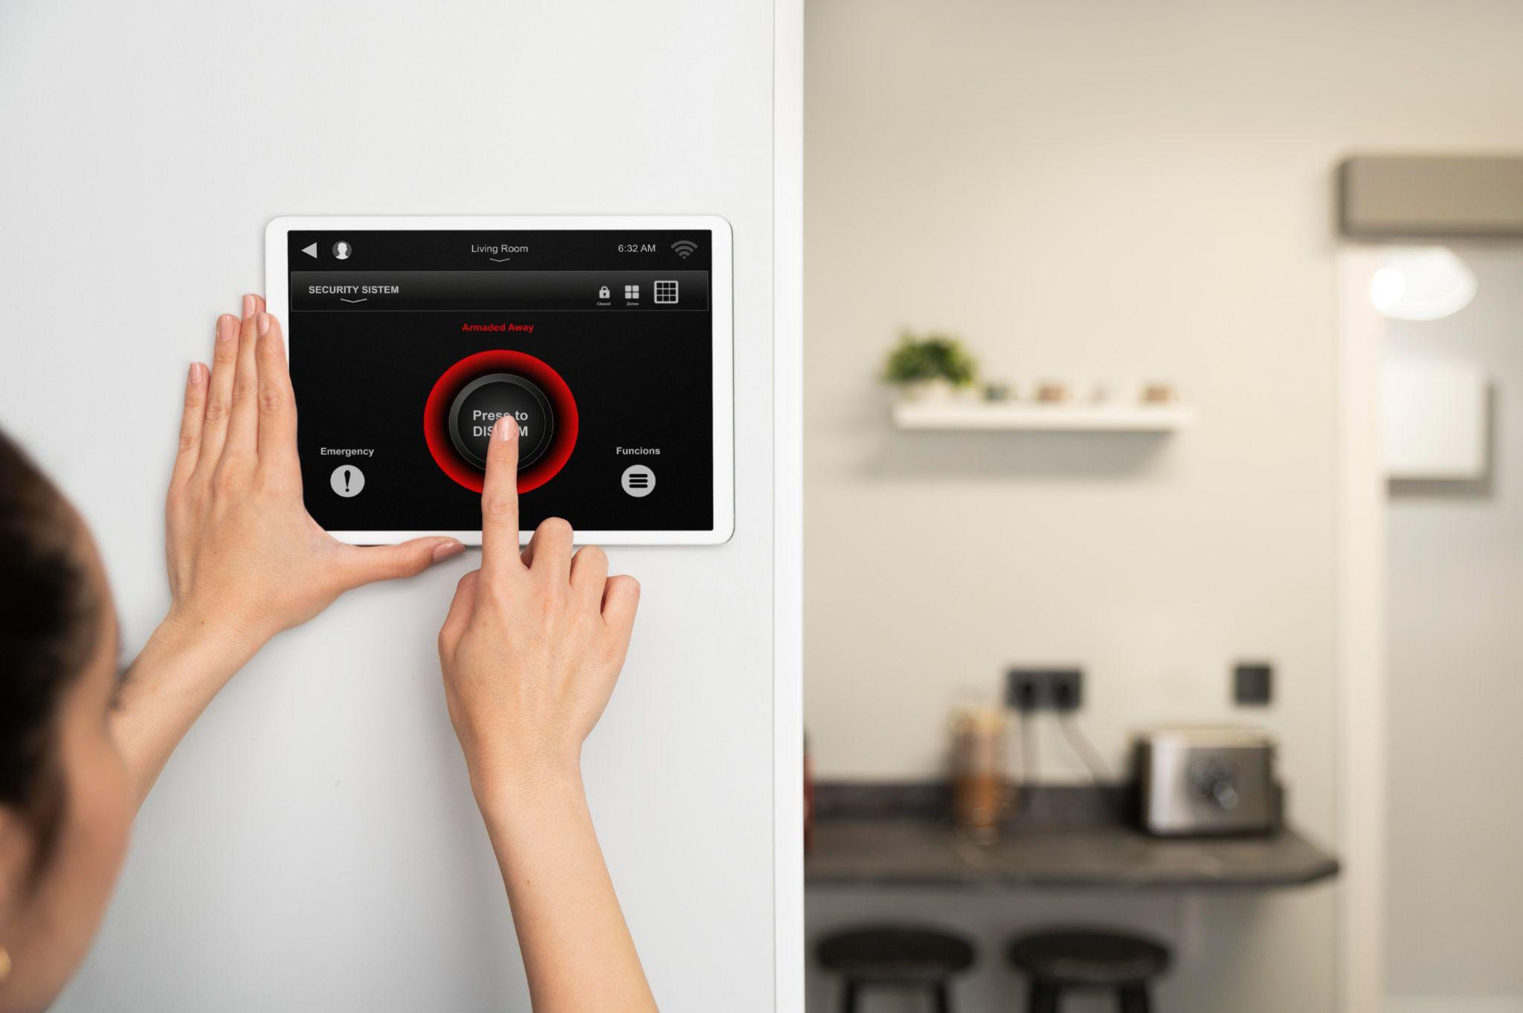
SMART DOOR LOCK
INTERNET OF THINGS

Slide 2
TABLE OF CONTENTS
Problem identification
01
03
Block diagram
02
Problem statement and Solution
04
Schematic Diagram
Working model in tinkercad
05

Slide 3
Problem identification
Key Management: Managing physical keys for multiple doors and users can be cumbersome and prone to key loss or duplication, compromising security.
Security Vulnerabilities: Traditional door locks are susceptible to picking, bumping, or forced entry, increasing the risk of unauthorized access and burglary.
Incompatibility with Smart Home Systems: Traditional door locks may not integrate seamlessly with smart home systems or home automation platforms, limiting their functionality and interoperability within the broader smart home ecosystem.
Physical Wear and Tear: Over time, traditional door locks may experience wear and tear due to frequent use, exposure to weather elements, or physical damage, reducing their effectiveness and reliability.

Slide 4
Problem statement
The current door lock systems lack advanced security features and remote accessibility, leading to concerns about unauthorized access, limited monitoring capabilities, and inconvenience for homeowners. Traditional locks also do not integrate well with modern smart home ecosystems, making it challenging to automate access control and enhance overall home security. Additionally, there is a need for a cost-effective and user-friendly solution that addresses these limitations while ensuring privacy and reliability

Slide 5
SOLUTION
Advanced Security Measures:
Implement robust encryption algorithms and authentication mechanisms to prevent unauthorized access and enhance overall security.
Remote Access and Monitoring:
Enable homeowners to remotely control and monitor the status of their door locks via a mobile application or web interface.
Durability and Reliability:
Engineer the smart door lock hardware and software components to withstand environmental factors (e.g., weather, physical impact) and ensure long-term reliability.

Slide 6
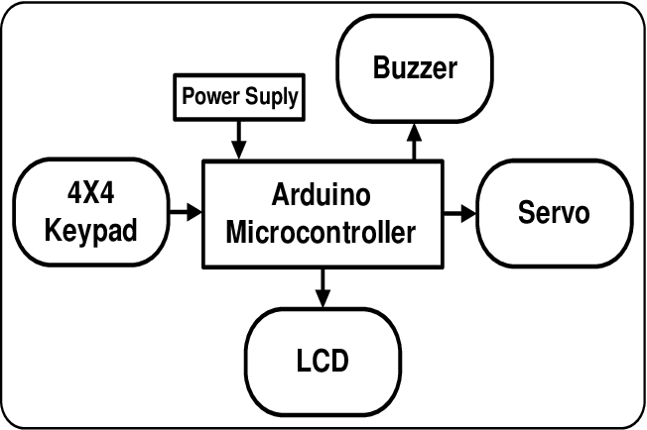
Block diagram

Slide 7
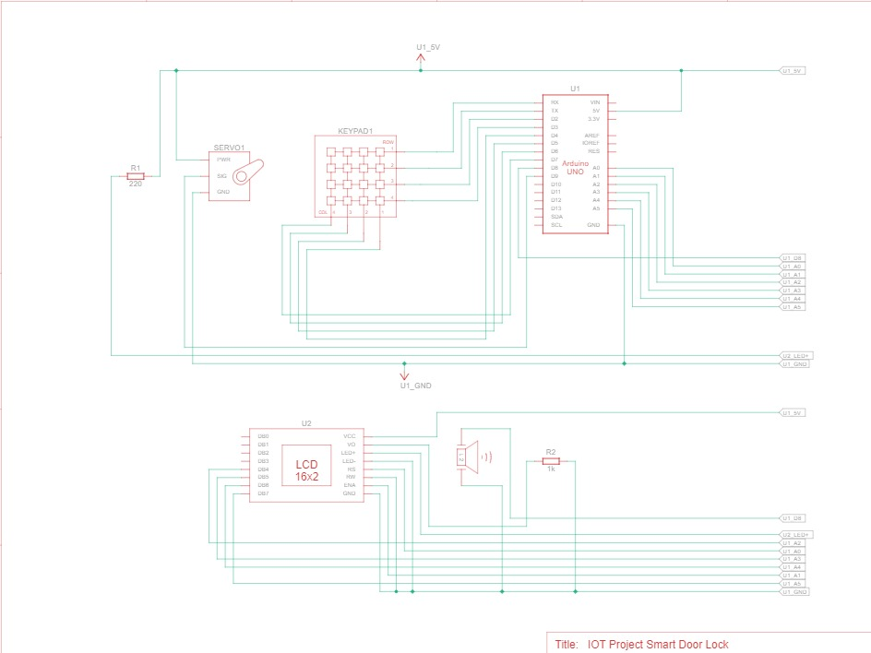
Schematic Diagram

Slide 8
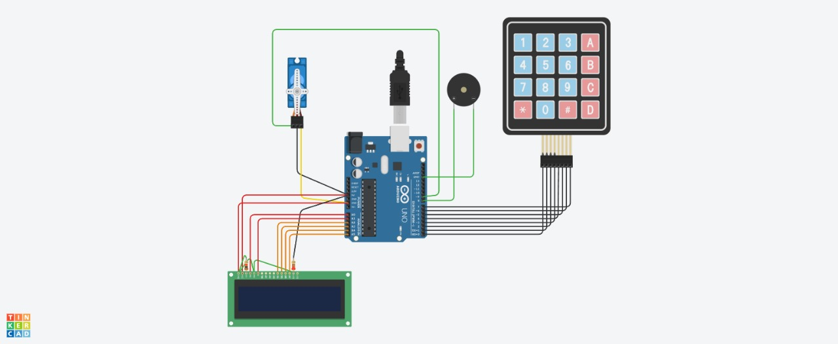
Working model in tinkercad

Slide 9
THANKS!

